Slide 1
Introduction to MapReduce
Source A. Haeberlen, Z. Ives
University of Pennsylvania
www.cis.upenn.edu/~nets212/slides/08-MapReduceIntro.pptx

Slide 2
Plan for today
Introduction
  Census example
MapReduce architecture
  Data flow
  Execution flow
  Fault tolerance etc.
NEXT

Slide 3
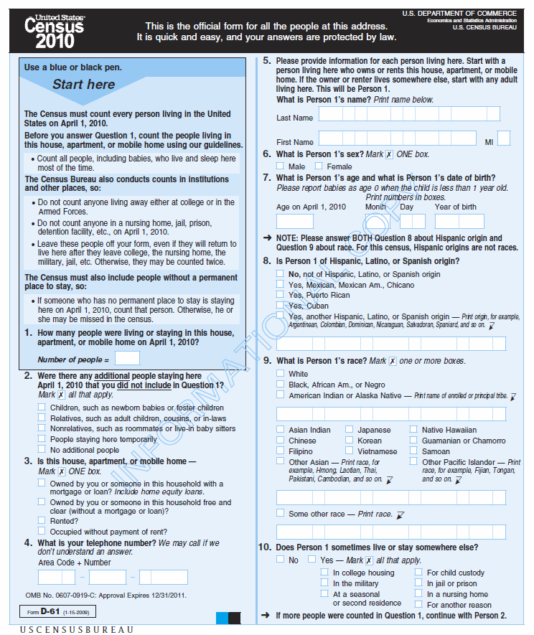
Analogy: National census
Suppose we have
10,000 employees,
whose job is to collate
census forms and
to determine how
many people live in
each city
How would you
organize this task?
http://www.census.gov/2010census/pdf/2010_Questionnaire_Info.pdf

Slide 4
Making things more complicated
Suppose people take vacations, get sick, work at different rates
Suppose some forms are incorrectly filled out and require corrections or need to be thrown away
What if the supervisor gets sick?
How big should the stacks be?
How do we monitor progress?
...

Slide 5
A bit of introspection
What is the main challenge?
  Are the individual tasks complicated?
  If not, what makes this so challenging?
How resilient is our solution?
How well does it balance work across employees?
  What factors affect this?
How general is the set of techniques?

Slide 6
I don't want to deal with all this!!!
Wouldn't it be nice if there were some system that took care of all these details for you?
Ideally, you'd just tell the system what needs to be done
That's the MapReduce framework.

Slide 7
Abstracting into a digital data flow
CountStack
Worker
Filter+Stack
Worker
blue: 4k
CountStack
Worker
green: 4k
Filter+Stack
Worker
CountStack
Worker
cyan: 3k
Filter+Stack
Worker
CountStack
Worker
gray: 1k
Filter+Stack
Worker
CountStack
Worker
orange: 4k

Slide 8
Abstracting once more
There are two kinds of workers:
  Those that take input data items and produce output items for the “stacks”
  Those that take the stacks and aggregate the results to produce outputs on a per-stack basis
We’ll call these:
  map: takes (item_key, value), produces one or more (stack_key, value’) pairs
  reduce: takes (stack_key, {set of value’}), produces one or more output results – typically (stack_key, agg_value)
We will refer to this key
as the reduce key

Slide 9
Why MapReduce?
Scenario:
  You have a huge amount of data, e.g., all the Google searches of the last three years
  You would like to perform a computation on the data, e.g., find out which search terms were the most popular
How would you do it?
Analogy to the census example:
  The computation isn't necessarily difficult, but parallelizing and distributing it, as well as handling faults, is challenging
Idea: A programming language!
  Write a simple program to express the (simple) computation, and let the language runtime do all the hard work

Slide 10

Plan for today
Introduction
  Census example
MapReduce architecture
  Data flow
  Execution flow
  Fault tolerance etc.
NEXT

Slide 11
What is MapReduce?
A famous distributed programming model
In many circles, considered the key building block for much of Google’s data analysis
  A programming language built on it: Sawzall,
  http://labs.google.com/papers/sawzall.html
  … Sawzall has become one of the most widely used programming languages at Google. … [O]n one dedicated Workqueue cluster with 1500 Xeon CPUs, there were 32,580 Sawzall jobs launched, using an average of 220 machines each. While running those jobs, 18,636 failures occurred (application failure, network outage, system crash, etc.) that triggered rerunning some portion of the job. The jobs read a total of 3.2x10¹⁵ bytes of data (2.8PB) and wrote 9.9x10¹² bytes (9.3TB).
  Other similar languages: Yahoo’s Pig Latin and Pig; Microsoft’s Dryad
Cloned in open source: Hadoop,
http://hadoop.apache.org/

Slide 12
The MapReduce programming model
Simple distributed functional programming primitives
Modeled after Lisp primitives:
  map (apply function to all items in a collection) and
  reduce (apply function to set of items with a common key)
We start with:
  A user-defined function to be applied to all data,
  map: (key,value) → (key, value)
  Another user-specified operation
  reduce: (key, {set of values}) → result
  A set of n nodes, each with data
All nodes run map on all of their data, producing new data with keys
  This data is collected by key, then shuffled, and finally reduced
  Dataflow is through temp files on GFS

Slide 13
Simple example: Word count
map(String key, String value) {
// key: document name, line no
// value: contents of line
}
reduce(String key, Iterator values) {
}
// key: a word
// values: a list of counts
int result = 0;
for each v in values:
result +=1;
emit(key, result)
for each word w in value:
emit(w, "1")
Goal: Given a set of documents, count how often each word occurs
  Input: Key-value pairs (document:lineNumber, text)
  Output: Key-value pairs (word, #occurrences)
  What should be the intermediate key-value pairs?

Slide 14
Simple example: Word count
Key range the node
is responsible for
(apple, 3)
(apple, 1)
(apple, 1)
(apple, 1)
Mapper
(1-2)
(apple, {1, 1, 1})
Reducer
(A-G)
(an, 2)
(an, {1, 1})
(an, 1)
(an, 1)
(because, 1)
(1, the apple)
(because, {1})
(because, 1)
(green, 1)
(green, {1})
(2, is an apple)
(green, 1)
Mapper
(3-4)
(is, 1)
(is, 1)
Reducer
(H-N)
(is, 2)
(3, not an orange)
(is, {1, 1})
(not, 1)
(not, 1)
(not, 2)
(not, {1, 1})
(4, because the)
(5, orange)
(orange, 1)
(orange, 1)
(orange, 1)
Mapper
(5-6)
(orange, {1, 1, 1})
Reducer
(O-U)
(orange, 3)
(the, {1, 1, 1})
(6, unlike the apple)
(the, 1)
(the, 1)
(the, 1)
(the, 3)
(unlike, {1})
(unlike, 1)
(7, is orange)
(unlike, 1)
(8, not green)
Mapper
(7-8)
Reducer
(V-Z)
2
The reducers
process their
input one group
at a time
1
The mappers
process the
KV-pairs
one by one
Each KV-pair output
by the mapper is sent to the reducer that is responsible for it
5
3
4
Each mapper
receives some
of the KV-pairs
as input
The reducers
sort their input
by key
and group it

Slide 15
MapReduce dataflow
Intermediate
(key,value) pairs
Mapper
Reducer
Mapper
Reducer
Input data
Output data
Mapper
Reducer
Mapper
Reducer
"The Shuffle"

Slide 16
More examples
Distributed grep – all lines matching a pattern
  Map: filter by pattern
  Reduce: output set
Count URL access frequency
  Map: output each URL as key, with count 1
  Reduce: sum the counts
Reverse web-link graph
  Map: output (target,source) pairs when link to target
  found in souce
  Reduce: concatenates values and emits (target,list(source))
Inverted index
  Map: Emits (word,documentID)
  Reduce: Combines these into (word,list(documentID))

Slide 17
Common mistakes to avoid
Mapper and reducer should be stateless
  Don't use static variables - after map +
  reduce return, they should remember
  nothing about the processed data!
  Reason: No guarantees about which
  key-value pairs will be processed by
  which workers!
Don't try to do your own I/O!
  Don't try to read from, or write to,
  files in the file system
  The MapReduce framework does all
  the I/O for you:
    All the incoming data will be fed as arguments to map and reduce
    Any data your functions produce should be output via emit
HashMap h = new HashMap();
map(key, value) {
if (h.contains(key)) {
h.add(key,value);
emit(key, "X");
}
}
Wrong!
map(key, value) {
File foo =
new File("xyz.txt");
while (true) {
s = foo.readLine();
...
}
}
Wrong!

Slide 18
More common mistakes to avoid
map(key, value) {
emit("FOO", key + " " + value);
}
reduce(key, value[]) {
/* do some computation on
all the values */
}
Wrong!
Mapper must not map too much data to the same key
  In particular, don't map everything to the same key!!
  Otherwise the reduce worker will be overwhelmed!
  It's okay if some reduce workers have more work than others
    Example: In WordCount, the reduce worker that works on the key 'and' has a lot more work than the reduce worker that works on 'syzygy'.

Slide 19
Designing MapReduce algorithms
Key decision: What should be done by map, and what by reduce?
  map can do something to each individual key-value pair, but
  it can't look at other key-value pairs
    Example: Filtering out key-value pairs we don't need
  map can emit more than one intermediate key-value pair for each incoming key-value pair
    Example: Incoming data is text, map produces (word,1) for each word
  reduce can aggregate data; it can look at multiple values, as long as map has mapped them to the same (intermediate) key
    Example: Count the number of words, add up the total cost, ...
Need to get the intermediate format right!
  If reduce needs to look at several values together, map
  must emit them using the same key!

Slide 20
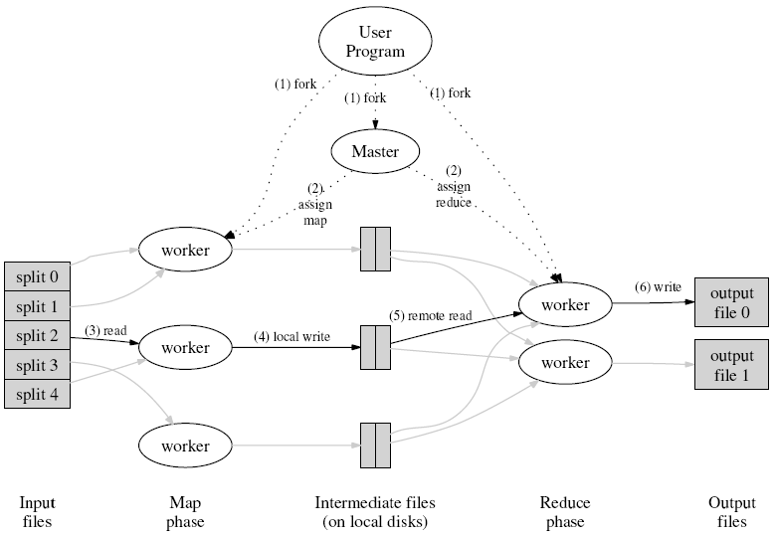
More details on the MapReduce data flow
Coordinator
(Default MapReduce
uses Filesystem)
Map computation partitions
Reduce computation partitions
Data partitions
by key
Redistribution
by output’s key
("shuffle")

Slide 21
Some additional details
To make this work, we need a few more parts…
The file system (distributed across all nodes):
  Stores the inputs, outputs, and temporary results
The driver program (executes on one node):
  Specifies where to find the inputs, the outputs
  Specifies what mapper and reducer to use
  Can customize behavior of the execution
The runtime system (controls nodes):
  Supervises the execution of tasks
  Mater (JobTracker)

Slide 22
Some details
Fewer computation partitions than data partitions
  All data is accessible via a distributed filesystem with replication
  Worker nodes produce data in key order (makes it easy to merge)
  The master is responsible for scheduling, keeping all nodes busy
  The master knows how many data partitions there are, which have completed – atomic commits to disk
Locality: Master tries to do work on nodes that have replicas of the data
Master can deal with stragglers (slow machines) by re-executing their tasks somewhere else

Slide 23
What if a worker crashes?
We rely on the file system being shared across all the nodes
Two types of (crash) faults:
  Node wrote its output and then crashed
    Here, the file system is likely to have a copy of the complete output
  Node crashed before finishing its output
    The JobTracker sees that the job isn’t making progress, and restarts the job elsewhere on the system
(Of course, we have fewer nodes to do work…)
But what if the master crashes?

Slide 24
Other challenges
Task granularity
  How many map tasks? How many reduce tasks?

